Slide 1
Training Neural Networks,
Part 2
AI Robotics KR
2019. 09. 02
발표자: 김영기

Slide 2
Last Time
1. Activation Functions
2. Weight Initialization
3. Data Preprocessing
4. Batch Normalization

Slide 3
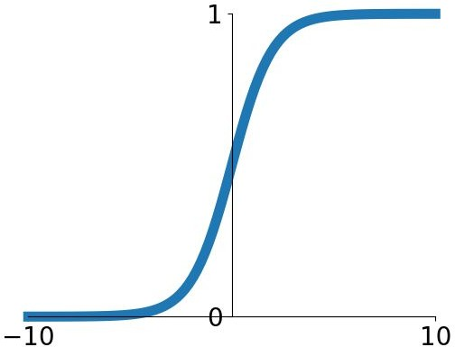
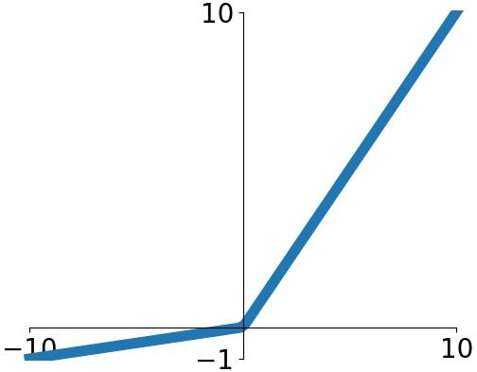
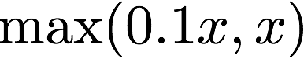
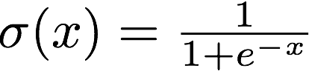
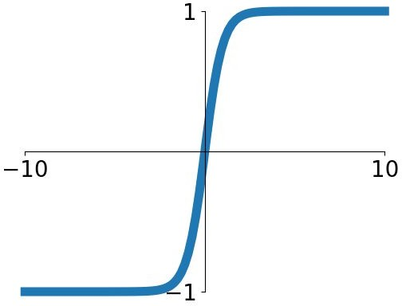
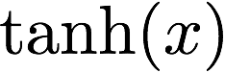
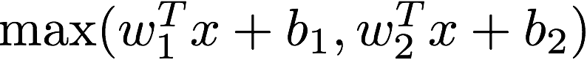
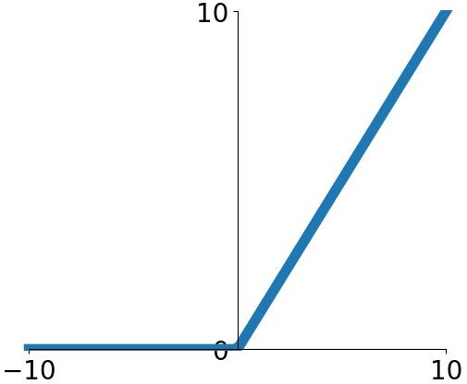
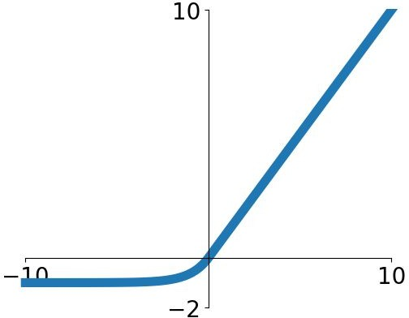
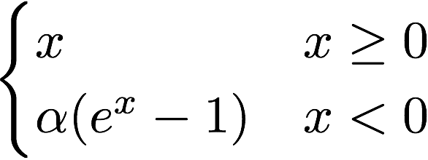
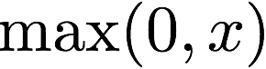
Last time: Activation Functions
Sigmoid
tanh
Leaky ReLU
Maxout
ReLU
Good default choice
ELU

Slide 4
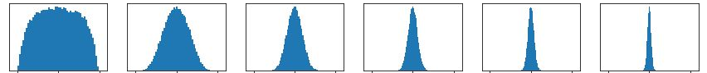
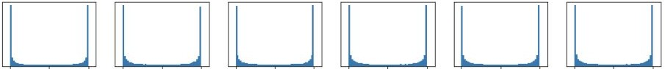
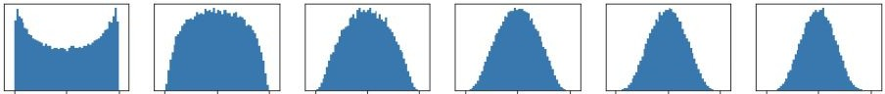
Last time: Weight Initialization
Initialization too small:
Activations go to zero, gradients also zero, No learning =(
Initialization too big:
Activations saturate (for tanh),
Gradients zero, no learning =(
Initialization just right:
Nice distribution of activations at all layers, Learning proceeds nicely

Slide 5
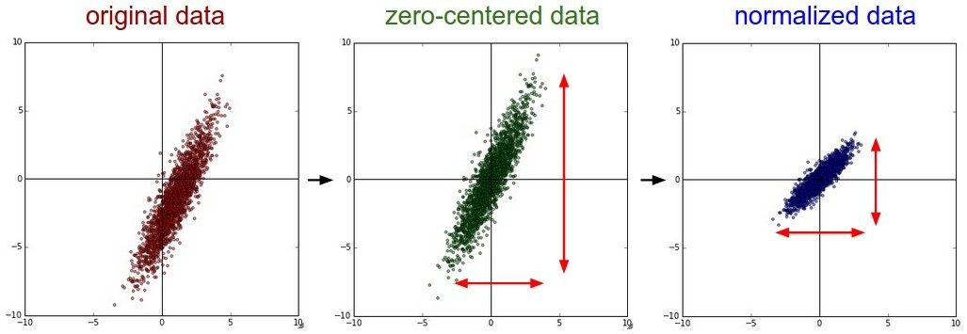
Last time: Data Preprocessing

Slide 6
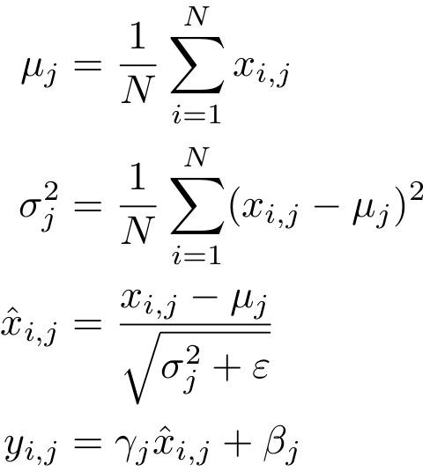
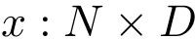
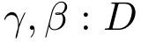
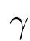
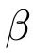
Last Time: Batch Normalization
[Ioffe and Szegedy, 2015]
Input:
Per-channel mean, shape is D
Learnable scale and shift parameters:
Per-channel var, shape is D
Normalized x, Shape is N x D
Learning = ,
= will recover the
Output,
Shape is N x D
identity function!

Slide 7
Today
Improve your training error:
Optimizers
Learning rate schedules
Improve your test error:
Regularization
Choosing Hyperparameters
Transfer Learning

Slide 8

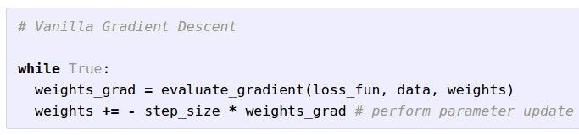

Optimization
W_2
W_1

Slide 9
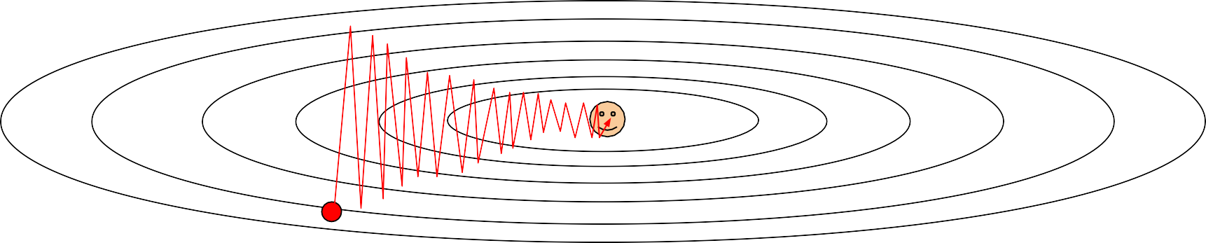
Optimization: Problems with SGD
What if loss changes quickly in one direction and slowly in another? What does gradient descent do?
Very slow progress along shallow dimension, jitter along steep direction
Loss function has high condition number: ratio of largest to smallest
singular value of the Hessian matrix is large
http://shuuki4.github.io/deep%20learning/2016/05/20/Gradient-Descent-Algorithm-Overview.html

Slide 10


Optimization: Problems with SGD
What if the loss function has a
local minima or saddle point?
Zero gradient,
gradient descent gets stuck
https://darkpgmr.tistory.com/m/148
Notes:
Local minima가 고차원 공간에서는 발생하기 힘든 경우이다.라고 주장하는 글도 있다.(정식 논문 x)

Slide 11
Optimization: Problems with SGD
What if the loss function has a
local minima or saddle point?
Saddle points much more common in high dimension
Dauphin et al, “Identifying and attacking the saddle point problem in high-dimensional non-convex optimization”, NIPS 2014

Slide 12
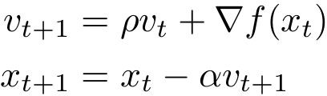
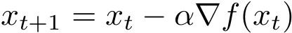
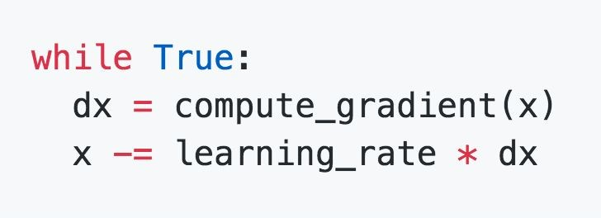
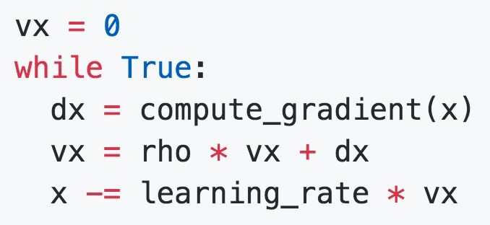
SGD + Momentum
SGD
SGD+Momentum
mu
Velocity는 하이퍼파라미터(X)
초기 값은 0로 설정
Build up “velocity” as a running mean of gradients
Rho gives “friction”; typically rho=0.9 or 0.99
Sutskever et al, “On the importance of initialization and momentum in deep learning”, ICML 2013
Notes:
p(rho): friction, 마찰 계수

Slide 13
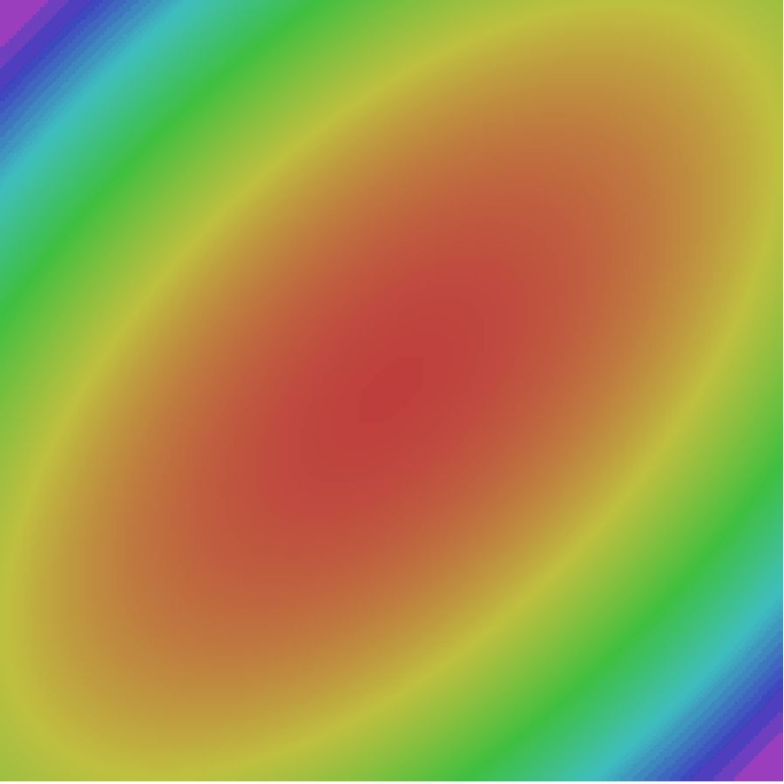
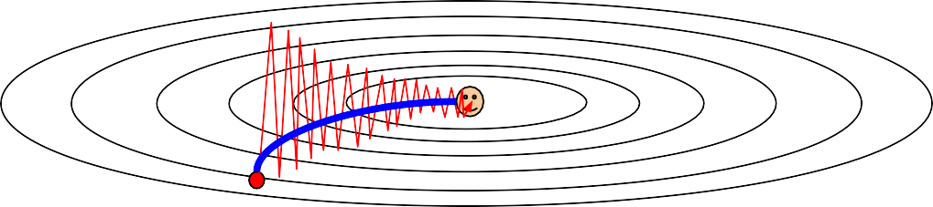
SGD + Momentum
Gradient Noise
Local Minima
Saddle points
Poor Conditioning
SGD
SGD+Momentum

Slide 14

SGD+Momentum
Momentum update:
Velocity
actual step
Gradient
Combine gradient at current point with
velocity to get step used to update weights
Nesterov, “A method of solving a convex programming problem with convergence rate O(1/k^2)”, 1983 Nesterov, “Introductory lectures on convex optimization: a basic course”, 2004
Sutskever et al, “On the importance of initialization and momentum in deep learning”, ICML 2013

Slide 15

Nesterov Momentum(NAG:Nesterov Accelerated Gradient)
Momentum update:
Nesterov Momentum
미끄러짐 효과(관성)
브레이크 효과(제동)
Gradient
Velocity
Velocity
actual step
actual step
Gradient
Combine gradient at current point with velocity to get step used to update weights
Nesterov, “A method of solving a convex programming problem with convergence rate O(1/k^2)”, 1983 Nesterov, “Introductory lectures on convex optimization: a basic course”, 2004
Sutskever et al, “On the importance of initialization and momentum in deep learning”, ICML 2013
“Look ahead” to the point where updating using
velocity would take us; compute gradient there and mix it with velocity to get actual update direction

Slide 16
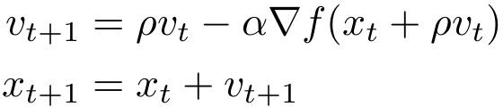
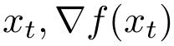
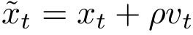
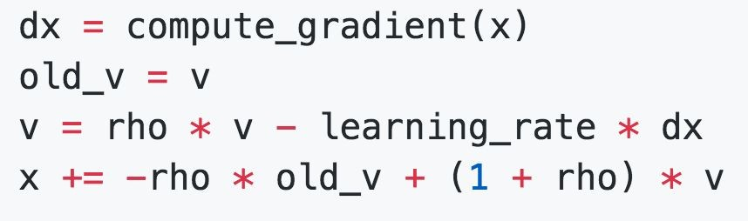
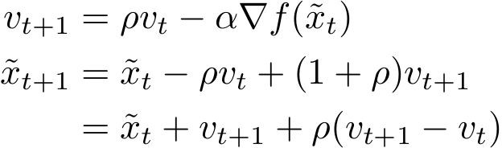
Nesterov Momentum
Annoying, usually we want update in terms of
Momentum을 먼저 고려해서, Momentum Step 이동을 예측한 것을 계산한 후 그 자리에서 Gradient를 구해서 Gradient Step을 이동.
Change of variables rearrange:
and

Slide 17
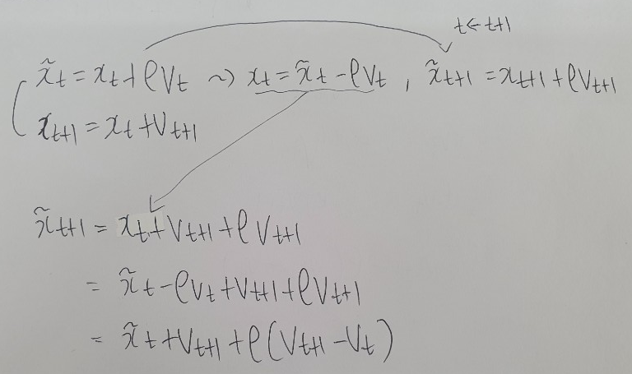
Nesterov Momentum
Change of variables rearrange:
and

Slide 18
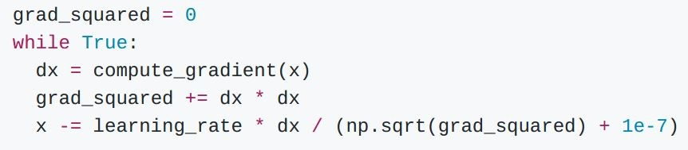
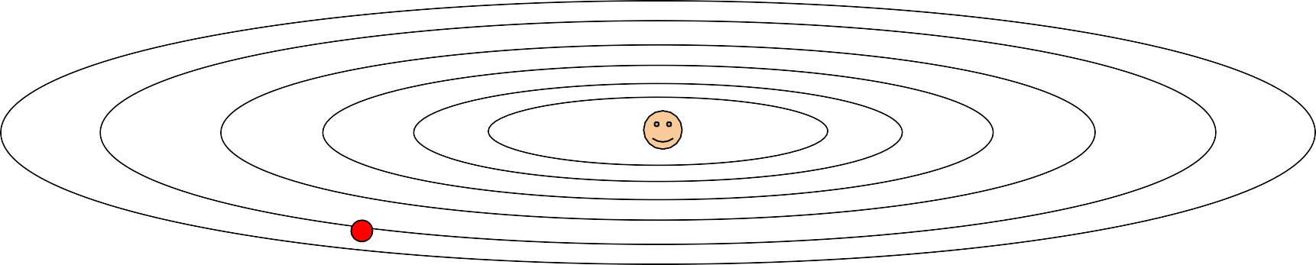
AdaGrad(Adaptive Gradient)
per-parameter adaptive learning rate method
지금까지 많이 변화하지 않은 변수들은 step size를 크게한다.
많이 변화했던 변수들은 step size를 작게한다.
0으로 나눠지지 않게
하기 위한 Constant
(0에 가까운 매우 작은 값을 사용)
1e-7, 1e-8, 5e-7, 10e-7 ….
Q1: What happens with AdaGrad?
Progress along “steep” directions is damped; progress along “flat” directions is accelerated
Q2: What happens to the step size over long time?
Decays to zero
Duchi et al, “Adaptive subgradient methods for online learning and stochastic optimization”, JMLR 2011

Slide 19

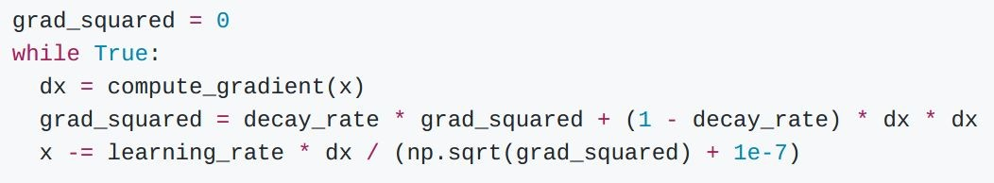
RMSProp: “Leaky AdaGrad”
AdaGrad
decay_rate개념을 추가하여 grad_squared 값이 무한정 커지는 것을
방지하고, 최근 변화량의 변수 간 상대적인 크기 차이를 유지할 수 있다.
RMSProp
* decay_rate: hyperparameter(usually use 0.9 or 0.99)
Tieleman and Hinton, 2012

Slide 20
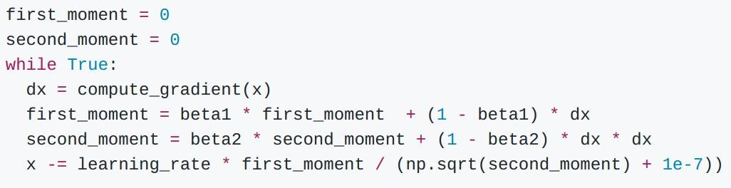
Adam (almost)
Momentum
AdaGrad / RMSProp
Sort of like RMSProp with momentum
Q: What happens at first timestep?
Momentum에서 초기 Velocity가 0이므로 처음 Momentum 값이 0에 가깝게 나온다.
따라서 분자가 커질 수 있어서 Step이 갑자기 튈 수가 있다.
Kingma and Ba, “Adam: A method for stochastic optimization”, ICLR 2015

Slide 21
Adam (almost)
Momentum
AdaGrad / RMSProp
Sort of like RMSProp with momentum
Q: What happens at first timestep?
AdaGrad
RMSProp
Momentum에서 초기 Velocity가 0이므로 처음 Momentum 값이 0에 가깝게 나온다.
따라서 분자가 커질 수 있어서 Step이 갑자기 튈 수가 있다.
Kingma and Ba, “Adam: A method for stochastic optimization”, ICLR 2015

Slide 22
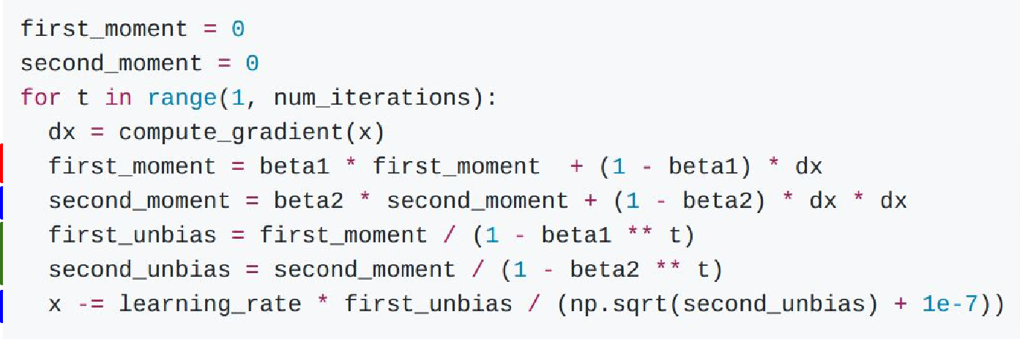
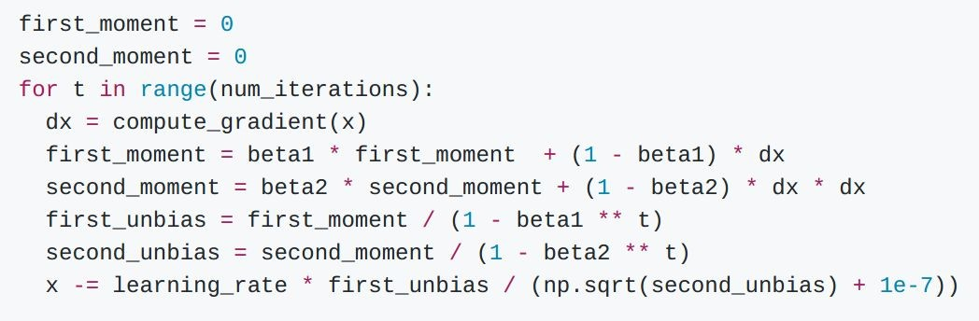
Adam (full form)
Momentum
Bias correction
AdaGrad / RMSProp
Bias correction for the fact that first and second moment
estimates start at zero
Kingma and Ba, “Adam: A method for stochastic optimization”, ICLR 2015

Slide 23
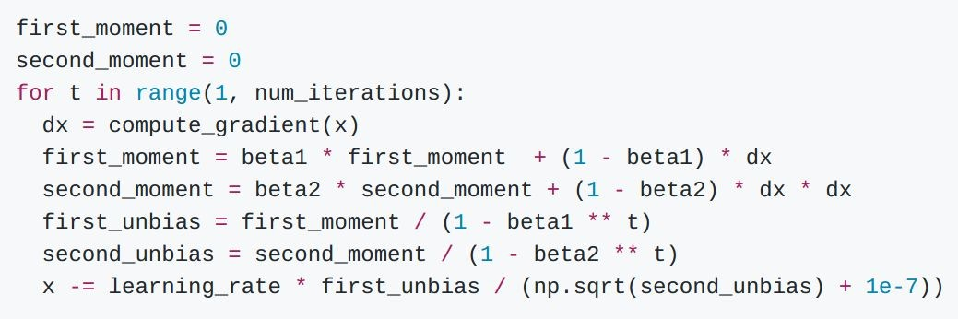
Adam (full form)
Momentum
Bias correction
AdaGrad / RMSProp
Bias correction for the fact that first and second moment estimates start at zero
Adam with beta1 = 0.9,
beta2 = 0.999, and learning_rate = 1e-3 or 5e-4 is a great starting point for many models!
Kingma and Ba, “Adam: A method for stochastic optimization”, ICLR 2015

Slide 24
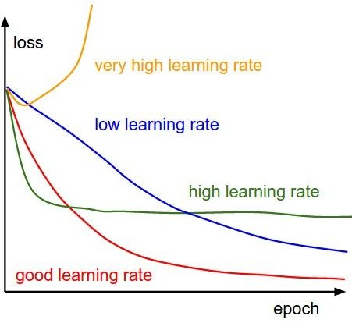
SGD, SGD+Momentum, Adagrad, RMSProp, Adam all have
learning rate as a hyperparameter.
Q: Which one of these learning rates is best to use?
A: All of them! Start with large
learning rate and decay over time

Slide 25
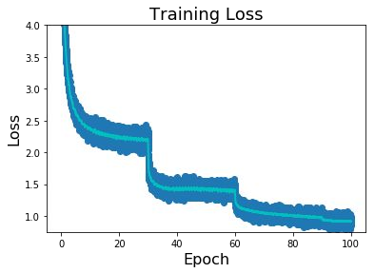
Learning Rate Decay
Step: Reduce learning rate at a few fixed
Reduce learning rate
points. E.g. for ResNets, multiply LR by 0.1 after epochs 30, 60, and 90.

Slide 26
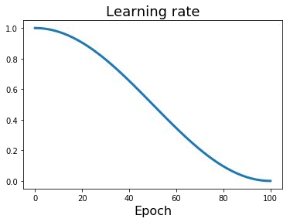
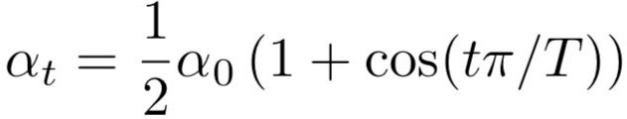
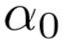
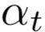
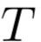
Learning Rate Decay
Step: Reduce learning rate at a few fixed points. E.g. for ResNets, multiply LR by 0.1 after epochs 30, 60, and 90.
Cosine:
: Initial learning rate
: Learning rate at epoch t
: Total number of epochs
Loshchilov and Hutter, “SGDR: Stochastic Gradient Descent with Warm Restarts”, ICLR 2017 Radford et al, “Improving Language Understanding by Generative Pre-Training”, 2018 Feichtenhofer et al, “SlowFast Networks for Video Recognition”, arXiv 2018
Child at al, “Generating Long Sequences with Sparse Transformers”, arXiv 2019

Slide 27
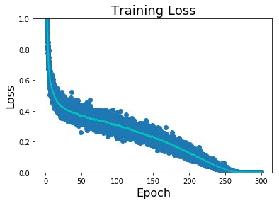
Learning Rate Decay
Step: Reduce learning rate at a few fixed points. E.g. for ResNets, multiply LR by 0.1 after epochs 30, 60, and 90.
Cosine:
: Initial learning rate
: Learning rate at epoch t
: Total number of epochs
Loshchilov and Hutter, “SGDR: Stochastic Gradient Descent with Warm Restarts”, ICLR 2017 Radford et al, “Improving Language Understanding by Generative Pre-Training”, 2018 Feichtenhofer et al, “SlowFast Networks for Video Recognition”, arXiv 2018
Child at al, “Generating Long Sequences with Sparse Transformers”, arXiv 2019

Slide 28
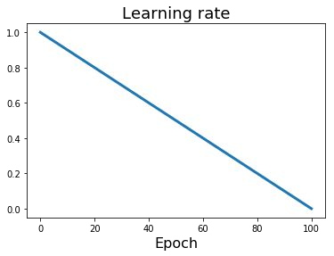

Learning Rate Decay
Step: Reduce learning rate at a few fixed points. E.g. for ResNets, multiply LR by 0.1 after epochs 30, 60, and 90.
Cosine: Linear:
: Initial learning rate
: Learning rate at epoch t
: Total number of epochs
Devlin et al, “BERT: Pre-training of Deep Bidirectional Transformers for
Language Understanding”, 2018

Slide 29


Learning Rate Decay
Step: Reduce learning rate at a few fixed points. E.g. for ResNets, multiply LR by 0.1 after epochs 30, 60, and 90.
Cosine: Linear: Inverse sqrt:
: Initial learning rate
: Learning rate at epoch t
: Total number of epochs
Vaswani et al, “Attention is all you need”, NIPS 2017

Slide 30

Learning Rate Decay: Linear Warmup
High initial learning rates can make loss explode; linearly increasing learning rate from 0 over the first ~5000 iterations can prevent this
Empirical rule of thumb: If you increase the batch size by N, also scale the initial learning rate by N
* what is epoch, batch size, iteration?
https://m.blog.naver.com/PostView.nhn?blogId=qbxlvnf11&logNo=221449297033&proxyReferer=https%3A%2F%2Fwww.google.com%2F
Goyal et al, “Accurate, Large Minibatch SGD: Training ImageNet in 1 Hour”, arXiv 2017

Slide 31
First-Order Optimization
Loss
w1

Slide 32

First-Order Optimization
Use gradient form linear approximation
Step to minimize the approximation
Loss
w1
Notes:
1차 미분

Slide 33

Second-Order Optimization
Use gradient and Hessian to form quadratic approximation
Step to the minima of the approximation
Loss
w1
Notes:
2차 미분

Slide 34

Second-Order Optimization
second-order Taylor expansion:
장점: No hyperparameters & learning rate
Hessian
Solving for the critical point we obtain the Newton parameter update:
Hessian has O(N^2) elements Inverting takes O(N^3)
N = (Tens or Hundreds of) Millions
Q: Why is this bad for deep learning?
Hessian Matrix는 nxn 행렬인데, 딥러닝에서는 파라미터 수가 수 천만 개이기 때문에 메모리에 올리기 힘들어서 사용하지 않는다.
https://lsjsj92.tistory.com/405

Slide 35
Second-Order Optimization
Quasi-Newton methods (BGFS most popular):
instead of inverting the Hessian (O(n^3)), approximate inverse Hessian with rank 1 updates over time (O(n^2) each).
L-BFGS (Limited memory BFGS):
Does not form/store the full inverse Hessian.
https://blog.naver.com/PostView.nhn?blogId=sw4r&logNo=221475376608&parentCategoryNo=&categoryNo=&viewDate=&isShowPopularPosts=false&from=postView
https://en.wikipedia.org/wiki/Limited-memory_BFGS

Slide 36
L-BFGS
- Usually works very well in full batch, deterministic mode
i.e. if you have a single, deterministic f(x) then L-BFGS will probably work very nicely
- Does not transfer very well to mini-batch setting. Gives bad results. Adapting second-order methods to large-scale, stochastic setting is an active area of research.
Le et al, “On optimization methods for deep learning, ICML 2011”
Ba et al, “Distributed second-order optimization using Kronecker-factored approximations”, ICLR 2017
https://darkpgmr.tistory.com/149

Slide 37
In practice:
Adam is a good default choice in most cases
If you can afford to do full batch updates then try out
L-BFGS (and don’t forget to disable all sources of noise)

Slide 38
Model Ensembles
Train multiple independent models
At test time average their results
(Take average of predicted probability distributions, then choose argmax)
Enjoy 2% extra performance
Notes:
강의에서 예시: 10개의 Model의 result를 평균을 내서 예측.
질문: 앙상블할 때 하이퍼파라미터가 같은가?
답변: 다를 수 있다.
Model Size, Learning Rate, Regularization등을 다르게 하면
다른 정확도가 나올 수도 있다

Slide 39


Model Ensembles: Tips and Tricks
Instead of training independent models, use multiple snapshots of a single model during training!
Cyclic learning rate schedules can make this work even better!
Loshchilov and Hutter, “SGDR: Stochastic gradient descent with restarts”, arXiv 2016 Huang et al, “Snapshot ensembles: train 1, get M for free”, ICLR 2017
Figures copyright Yixuan Li and Geoff Pleiss, 2017. Reproduced with permission.

Slide 40

How to improve single-model performance?
Regularization

Slide 41



Regularization: Add term to loss
In common use: L2 regularization L1 regularization
Elastic net (L1 + L2)
(Weight decay)

Slide 42

Regularization: Dropout
In each forward pass, randomly set some neurons to zero Probability of dropping is a hyperparameter; 0.5 is common
Srivastava et al, “Dropout: A simple way to prevent neural networks from overfitting”, JMLR 2014

Slide 43


Regularization: Dropout
Example forward pass with a
3-layer network using dropout
https://www.youtube.com/watch?v=5t1E3LZ3FDY&list=PL1Kb3QTCLIVtyOuMgyVgT-OeW0PYXl3j5&index=5 (28:20 *H1.shape에 대한 설명)

Slide 44

Regularization: Dropout
How can this possibly be a good idea?
Forces the network to have a redundant representation; Prevents co-adaptation of features
has an ear
has a tail is furry has claws
mischievous X
look
X
X
cat score

Slide 45
Regularization: Dropout
How can this possibly be a good idea?
Another interpretation:
Dropout is training a large ensemble of models (that share parameters).
Each binary mask is one model
An FC layer with 4096 units has 2⁴⁰⁹⁶ ~ 10¹²³³ possible masks!
Only ~ 10⁸² atoms in the universe...

Slide 46


Dropout: Test time
Output (label)
Input (image)
Dropout makes our output random!
Random mask
Want to “average out” the randomness at test-time
But this integral seems hard …

Slide 47




Dropout: Test time
Want to approximate the integral
Consider a single neuron.
a
At test time we have: During training we have:
w₁
w₂
x
y
At test time, multiply
by dropout probability

Slide 48

Dropout: Test time
At test time all neurons are active always
=> We must scale the activations so that for each neuron: output at test time = expected output at training time

Slide 49

Dropout Summary
drop in forward pass
scale at test time

Slide 50

More common: “Inverted dropout”
test time is unchanged!

Slide 51

Regularization: A common pattern
Training: Add some kind of randomness
Testing: Average out randomness (sometimes approximate)

Slide 52
Regularization: A common pattern
Training: Add some kind of randomness
Example: Batch Normalization
Training: Normalize using stats from random minibatches
Testing: Use fixed stats to normalize
Testing: Average out randomness (sometimes approximate)

Slide 53

Regularization: Data Augmentation
“cat”
Load image and label
Compute loss
CNN
This image by Nikita is licensed under CC-BY 2.0
https://nittaku.tistory.com/272

Slide 54

Regularization: Data Augmentation
“cat”
Load image and label
Compute loss
CNN
Transform image

Slide 55

Data Augmentation
Horizontal Flips

Slide 56
Data Augmentation
Random crops and scales
Training: sample random crops / scales
ResNet:
Pick random L in range [256, 480]
Resize training image, short side = L
Sample random 224 x 224 patch

Slide 57
Data Augmentation
Random crops and scales
Training: sample random crops / scales
ResNet:
Pick random L in range [256, 480]
Resize training image, short side = L
Sample random 224 x 224 patch
Testing: average a fixed set of crops
ResNet:
1. Resize image at 5 scales: {224, 256, 384, 480, 640}
2. For each size, use 10 224 x 224 crops: 4 corners + center, + flips

Slide 58

Data Augmentation
Color Jitter
Simple: Randomize contrast and brightness

Slide 59
Data Augmentation
Color Jitter
Simple: Randomize contrast and brightness
More Complex:
Apply PCA to all [R, G, B] pixels in training set
Sample a “color offset” along principal component directions
Add offset to all pixels of a training image
(As seen in [Krizhevsky et al. 2012], ResNet, etc)

Slide 60
Data Augmentation
Get creative for your problem!
Random mix/combinations of :
translation
rotation
stretching
shearing,
lens distortions, … (go crazy)

Slide 61
Regularization: DropConnect
Training: Drop connections between neurons (set weights to 0)
Testing: Use all the connections
Examples:
Dropout
Batch Normalization Data Augmentation DropConnect
Wan et al, “Regularization of Neural Networks using DropConnect”, ICML 2013

Slide 62

Regularization: Fractional Pooling
Training: Use randomized pooling regions
Testing: Average predictions from several regions
Examples:
Dropout
Batch Normalization Data Augmentation
DropConnect
Fractional Max Pooling
Graham, “Fractional Max Pooling”, arXiv 2014

Slide 63
Regularization: Stochastic Depth
Training: Skip some layers in the network
Testing: Use all the layer
Examples:
Dropout
Batch Normalization Data Augmentation
DropConnect
Fractional Max Pooling Stochastic Depth
Huang et al, “Deep Networks with Stochastic Depth”, ECCV 2016

Slide 64
Regularization: Cutout
Training: Set random image regions to zero
Testing: Use full image
Examples:
Dropout
Batch Normalization Data Augmentation
DropConnect
Fractional Max Pooling Stochastic Depth
Cutout
Works very well for small datasets like CIFAR, less common for large datasets like ImageNet
DeVries and Taylor, “Improved Regularization of Convolutional Neural Networks with Cutout”, arXiv 2017

Slide 65


Regularization: Mixup
Training: Train on random blends of images
Testing: Use original images
Examples:
Dropout
Batch Normalization Data Augmentation
DropConnect
Fractional Max Pooling
Target label: cat: 0.4
dog: 0.6
CNN
Stochastic Depth Cutout
Mixup
Zhang et al, “mixup: Beyond Empirical Risk Minimization”, ICLR 2018
Randomly blend the pixels of pairs of training images,
e.g. 40% cat, 60% dog

Slide 66
Regularization
Training: Add random noise
Testing: Marginalize over the noise
Examples:
Dropout
Batch Normalization Data Augmentation
DropConnect
Fractional Max Pooling
Stochastic Depth
Cutout
Mixup
Consider dropout for large fully-connected layers
Batch normalization and data augmentation almost always a good idea
Try cutout and mixup especially for small classification datasets

Slide 67
Choosing Hyperparameters
(without tons of GPUs)

Slide 68
Choosing Hyperparameters
Step 1: Check initial loss
Turn off weight decay, sanity check loss at initialization
e.g. log(C) for softmax with C classes

Slide 69
Choosing Hyperparameters
Step 1: Check initial loss
Step 2: Overfit a small sample
Try to train to 100% training accuracy on a small sample of training data (~5-10 minibatches); fiddle with architecture, learning rate, weight initialization
Loss not going down? LR too low, bad initialization
Loss explodes to Inf or NaN? LR too high, bad initialization

Slide 70
Choosing Hyperparameters
Step 1: Check initial loss
Step 2: Overfit a small sample
Step 3: Find LR that makes loss go down
Use the architecture from the previous step, use all training data, turn on small weight decay, find a learning rate that makes the loss drop significantly within ~100 iterations
Good learning rates to try: 1e-1, 1e-2, 1e-3, 1e-4

Slide 71
Choosing Hyperparameters
Step 1: Check initial loss
Step 2: Overfit a small sample
Step 3: Find LR that makes loss go down
Step 4: Coarse grid, train for ~1-5 epochs
Choose a few values of learning rate and weight decay around what worked from Step 3, train a few models for ~1-5 epochs.
Good weight decay to try: 1e-4, 1e-5, 0

Slide 72
Choosing Hyperparameters
Step 1: Check initial loss
Step 2: Overfit a small sample
Step 3: Find LR that makes loss go down Step 4: Coarse grid, train for ~1-5 epochs Step 5: Refine grid, train longer
Pick best models from Step 4, train them for longer (~10-20 epochs) without learning rate decay

Slide 73
Choosing Hyperparameters
Step 1: Check initial loss
Step 2: Overfit a small sample
Step 3: Find LR that makes loss go down Step 4: Coarse grid, train for ~1-5 epochs Step 5: Refine grid, train longer
Step 6: Look at loss curves

Slide 74


Look at learning curves!
Training Loss
Train / Val Accuracy
Losses may be noisy, use a scatter plot and also plot moving average to see trends better

Slide 75
Loss
Bad initialization a prime suspect
time

Slide 76
Loss
Loss plateaus: Try learning rate decay
time

Slide 77
Loss
Learning rate step decay
Loss was still going down when learning rate dropped, you decayed too early!
time

Slide 78
Accuracy still going up, you need to train longer
Accuracy
Train
Val
time

Slide 79
Huge train / val gap means overfitting! Increase regularization, get more data
Accuracy
Train
Val
time

Slide 80
No gap between train / val means underfitting: train longer, use a bigger model
Accuracy
Train
Val
time

Slide 81
Choosing Hyperparameters
Step 1: Check initial loss
Step 2: Overfit a small sample
Step 3: Find LR that makes loss go down Step 4: Coarse grid, train for ~1-5 epochs Step 5: Refine grid, train longer
Step 6: Look at loss curves
Step 7: GOTO step 5

Slide 82
Transfer Learning
“You need a lot of a data if you want to train/use CNNs”

Slide 83
Transfer Learning
“You need a lot of a data if you want to train/use CNNs”
BUSTED

Slide 84
Transfer Learning
●Transfer Learning 이란?
기존의 만들어진 모델을 사용하여 새로운 모델을 만들 시 학습을 빠르게 하며,
예측을 더 높이는 방법입니다.
● 사용하는 4가지 시나리오
1. 새로 훈련할 데이터가 적지만 original 데이터와 유사할 경우
2. 새로 훈련할 데이터가 매우 많으며 original 데이터와 유사할 경우
3. 새로 훈련할 데이터가 적으며 original 데이터와 다른 경우
4. 새로 훈련할 데이터가 많지만 original 데이터와 다른 경우
http://incredible.ai/artificial-intelligence/2017/05/13/Transfer-Learning/
http://cs231n.github.io/transfer-learning/

Slide 85
Takeaway for your projects and beyond:
Have some dataset of interest but it has < ~1M images?
Find a very large dataset that has similar data, train a big ConvNet there
Transfer learn to your dataset
Deep learning frameworks provide a “Model Zoo” of pretrained models so you don’t need to train your own
Caffe: https://github.com/BVLC/caffe/wiki/Model-Zoo TensorFlow: https://github.com/tensorflow/models
PyTorch: https://github.com/pytorch/vision

Slide 86
QnA

